Slide 1
Chapter 13
CORRELATION

Slide 2
How do 2 variables relate?
If you do well in statistics, will you also do well in experimental?
Is being American bad for your health?
Will studying for longer periods of time increase test scores?
If I did well on the SAT, will I also do well on the GRE?
Correlation is the association (or relation) between two variables

Slide 3
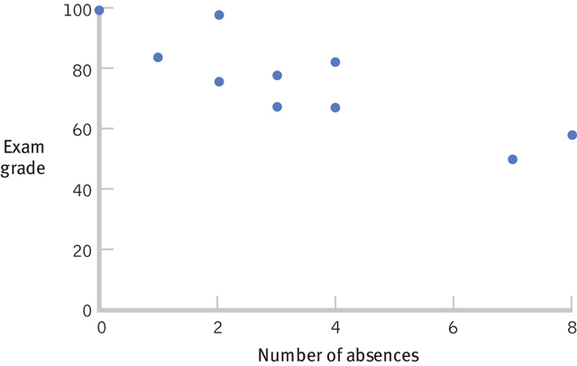
Bivariate Distribution
Joint distribution of 2 variables
Scores are paired
Typically, the same person provides 2 scores: 1 for each variable
Sub. | X | Y
1 | 0 | 100
2 | 1 | 83
3 | 2 | 78
4 | 2 | 98
… | … | …

Slide 4
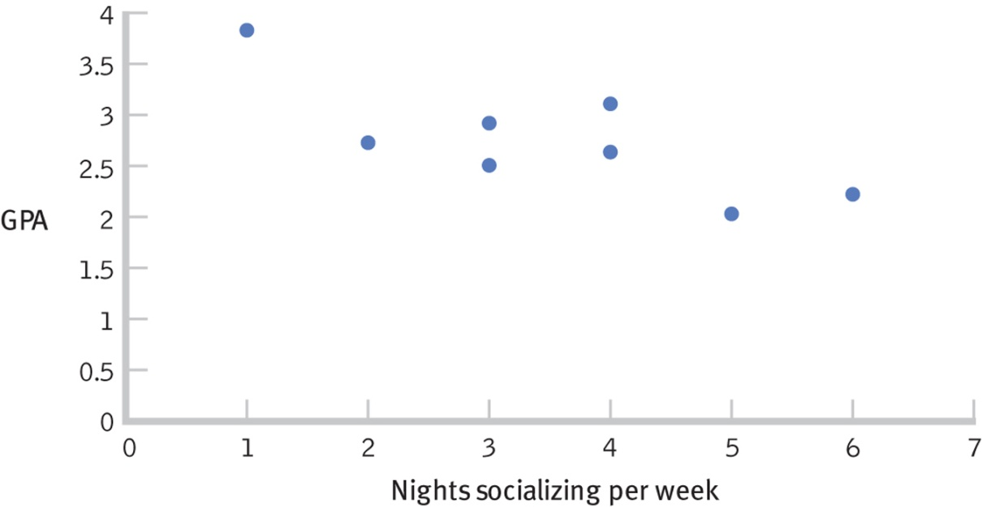
Negative Correlation
Definition: Subjects with high scores on one variable tend to have low scores on the other variable

Slide 5
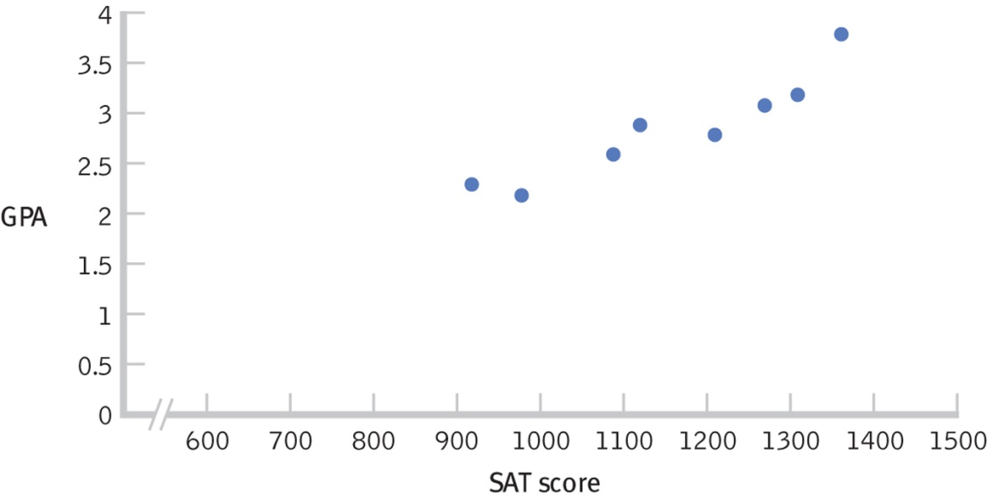
Positive Correlation
Definition: Subjects with high scores on one variable tend to have high scores on the other variable
Also, subjects with low scores on one variable tend to have low scores on the other variable

Slide 6
Correlation Coefficient
Definition: Statistic that quantifies the relation between two variables
A measure of the tendency for paired scores to vary systematically…
  High grade in Class A, high grade in Class B
  Low grade in Class A, low grade in Class B

Slide 7
Correlation Coefficient
In most of our examples, we’re comparing 2 sets of scores that can have very different values
  Height and shoe size
  Temperature and heating costs
What can we use to compare different scores?
  Hint: You know this! What was the statistic we learned before t tests?

Slide 8
Z scores!
Would a z scores in the following two categories vary together?
  SAT Math and SAT Verbal
  IQ and GPA
  Grades in History & Philosophy classes
This is the idea of covariance…
X – M
z =
Reflects standardized deviation from mean, or
how much a particular score deviates from
the mean.
SD

Slide 9
Variance vs. Covariance
What does sample variance describe?
The tendency of scores to depart from the sample mean

Slide 10
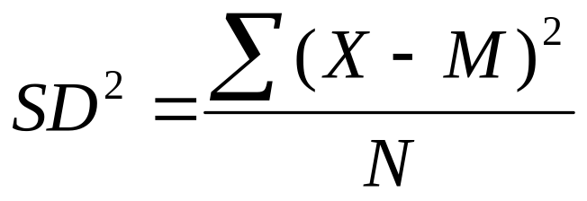
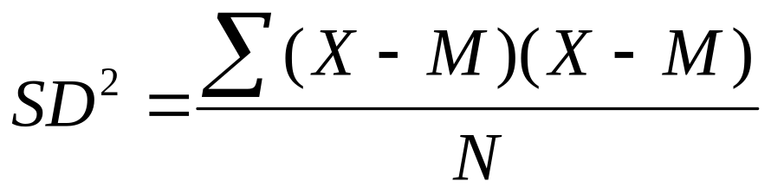
Variance vs. Covariance

Slide 11
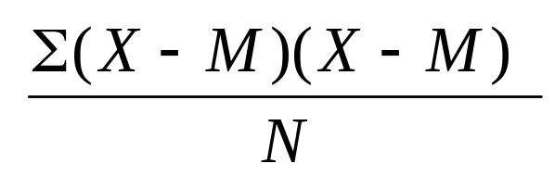
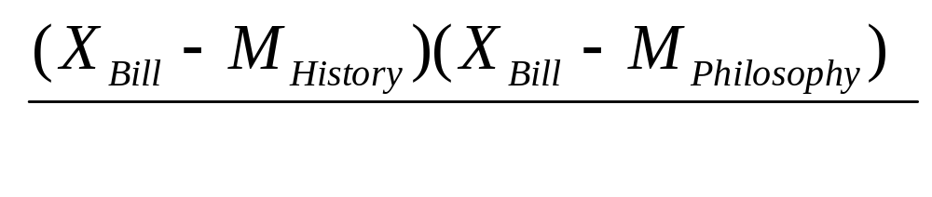
Will Bill’s score be small or large…positive or negative?
History
Philosophy
84%
75%
If Bill is here:
and here:
X
X

Slide 12
Covariance
If scores tend to fall on the same side of the mean and extremes are repeated
  Then, the product of paired deviation scores will be large and positive
If scores tend to fall on opposite sides of the mean and extremes are repeated
  Then, the product of paired deviation scores will be large and negative

Slide 13
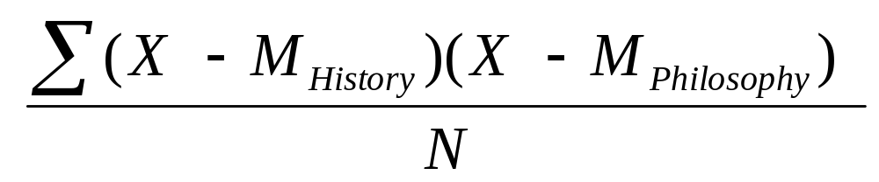
Covariance
To capture this tendency, we simply take the average of the deviation products:
This is covariance.

Slide 14
What about units of measurement?
Data set 1 = History %; Data set 2 = Philosophy %
  Percentages squared
What if you were measuring covariance between IQ and income?
  IQ-dollars

Slide 15
What about units of measurement?
Need to put covariance measure into common, or standardized scale.
How did we do this with z scores?

Slide 16
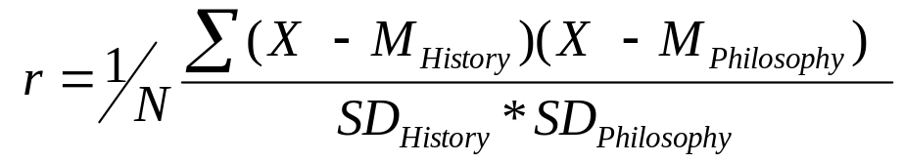
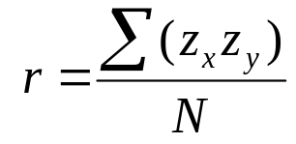
Covariance
To standardize the scale of covariance, divide by the product of the two sample standard deviations
This value is the Correlation Coefficient (r) or more formally, Pearson’s Product Moment Correlation Coefficient.
=

Slide 17
Three Characteristics of r
1. r can be either positive or negative
2. r ranges in value from a -1.0 to +1.0
3. It is the strength (magnitude) of the coefficient, not its sign, that indicates how large it is

Slide 18
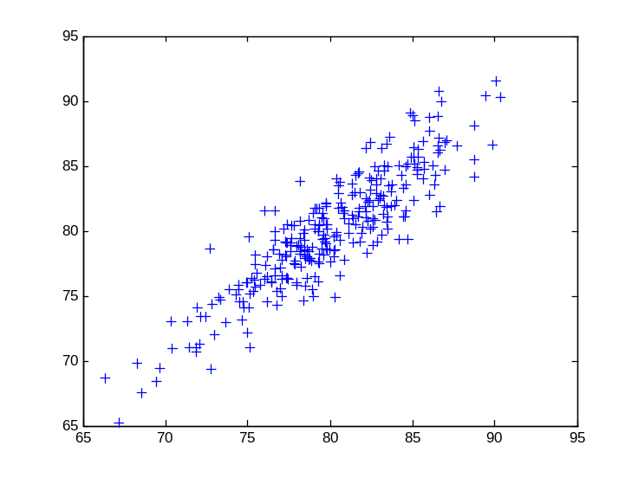
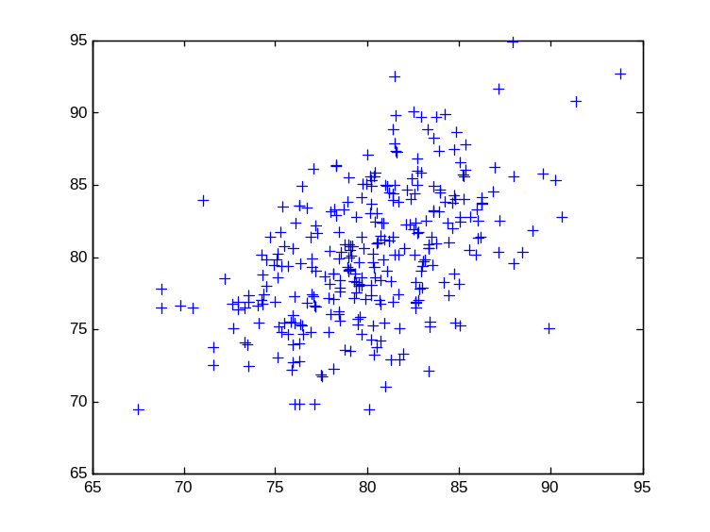
Positive Correlation
Philosophy
Philosophy
History
History
r = .89
r = .50

Slide 19
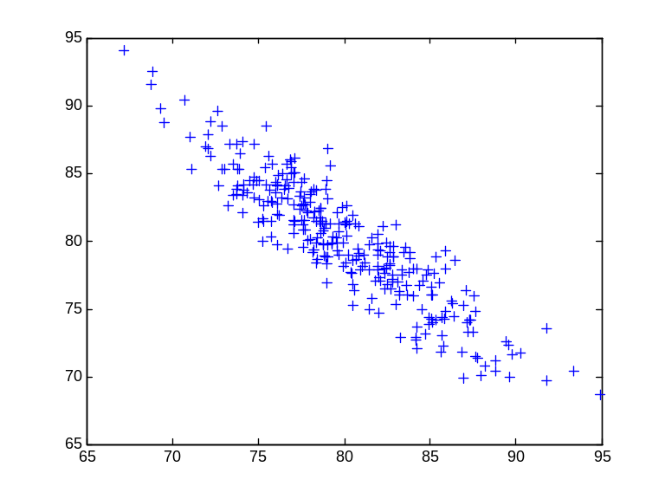
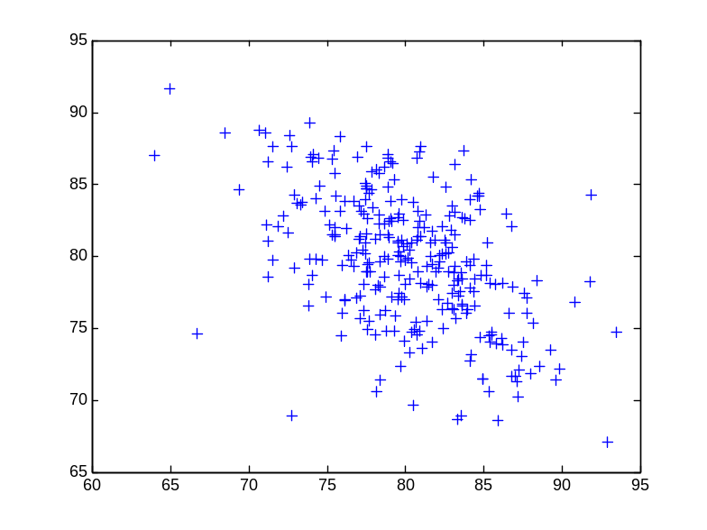
Negative Correlation
Philosophy
Philosophy
History
History
r = -.91
r = -.49

Slide 20
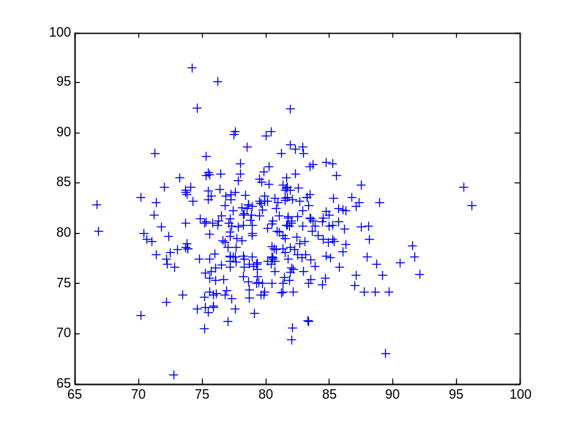
Zero Correlation
Philosophy
History
r = -.0047

